Slide 1
Global AI Night 2021
By: Vinay Venkatesh
Lynbrook High School, San Jose, CA
Vinayven.com
GitHub.com/Simple2006
Linkedin.com/in/vinayven

Slide 2
About Me
Freshman at Lynbrook High School
Robotics
Avid Programmer and Aspiring Researcher
Languages of Interest: Python, HTML/CSS, JavaScript, Golang Etc.
Frameworks of Interest: ReactJS, TensorFlow, PyTorch
Deep Interest in AI
Computer Vision

Slide 3
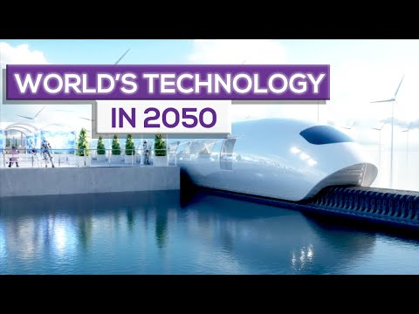
Why is AI the Future?
"AI is The Future" - Is it?
2:20

Slide 4
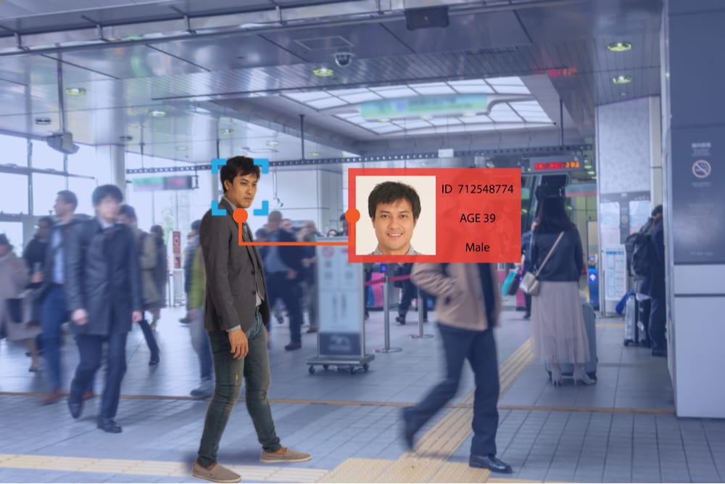
How Will AI Benefit Our Future?
Robotics
Autonomous Robots
Computer Vision
Facial Recognition
Ex. ArmVision
Natural Language Processing
Machines Interpreting Human Language
And More!
“[AI] is going to change the world more than anything in the history of mankind. More than electricity.”— AI oracle and venture capitalist Dr. Kai-Fu Lee, 2018

Slide 5
Existing AI Solutions
Google's AI Powered Predictions
Analyze movement speeds of traffic at any given time
Commercial Flights
AI Autopilots
Email Spam Filters
Spam Filters Updating With ML Algorithms
Plagiarism Checkers
Used to check source code, essays, and many more

Slide 6
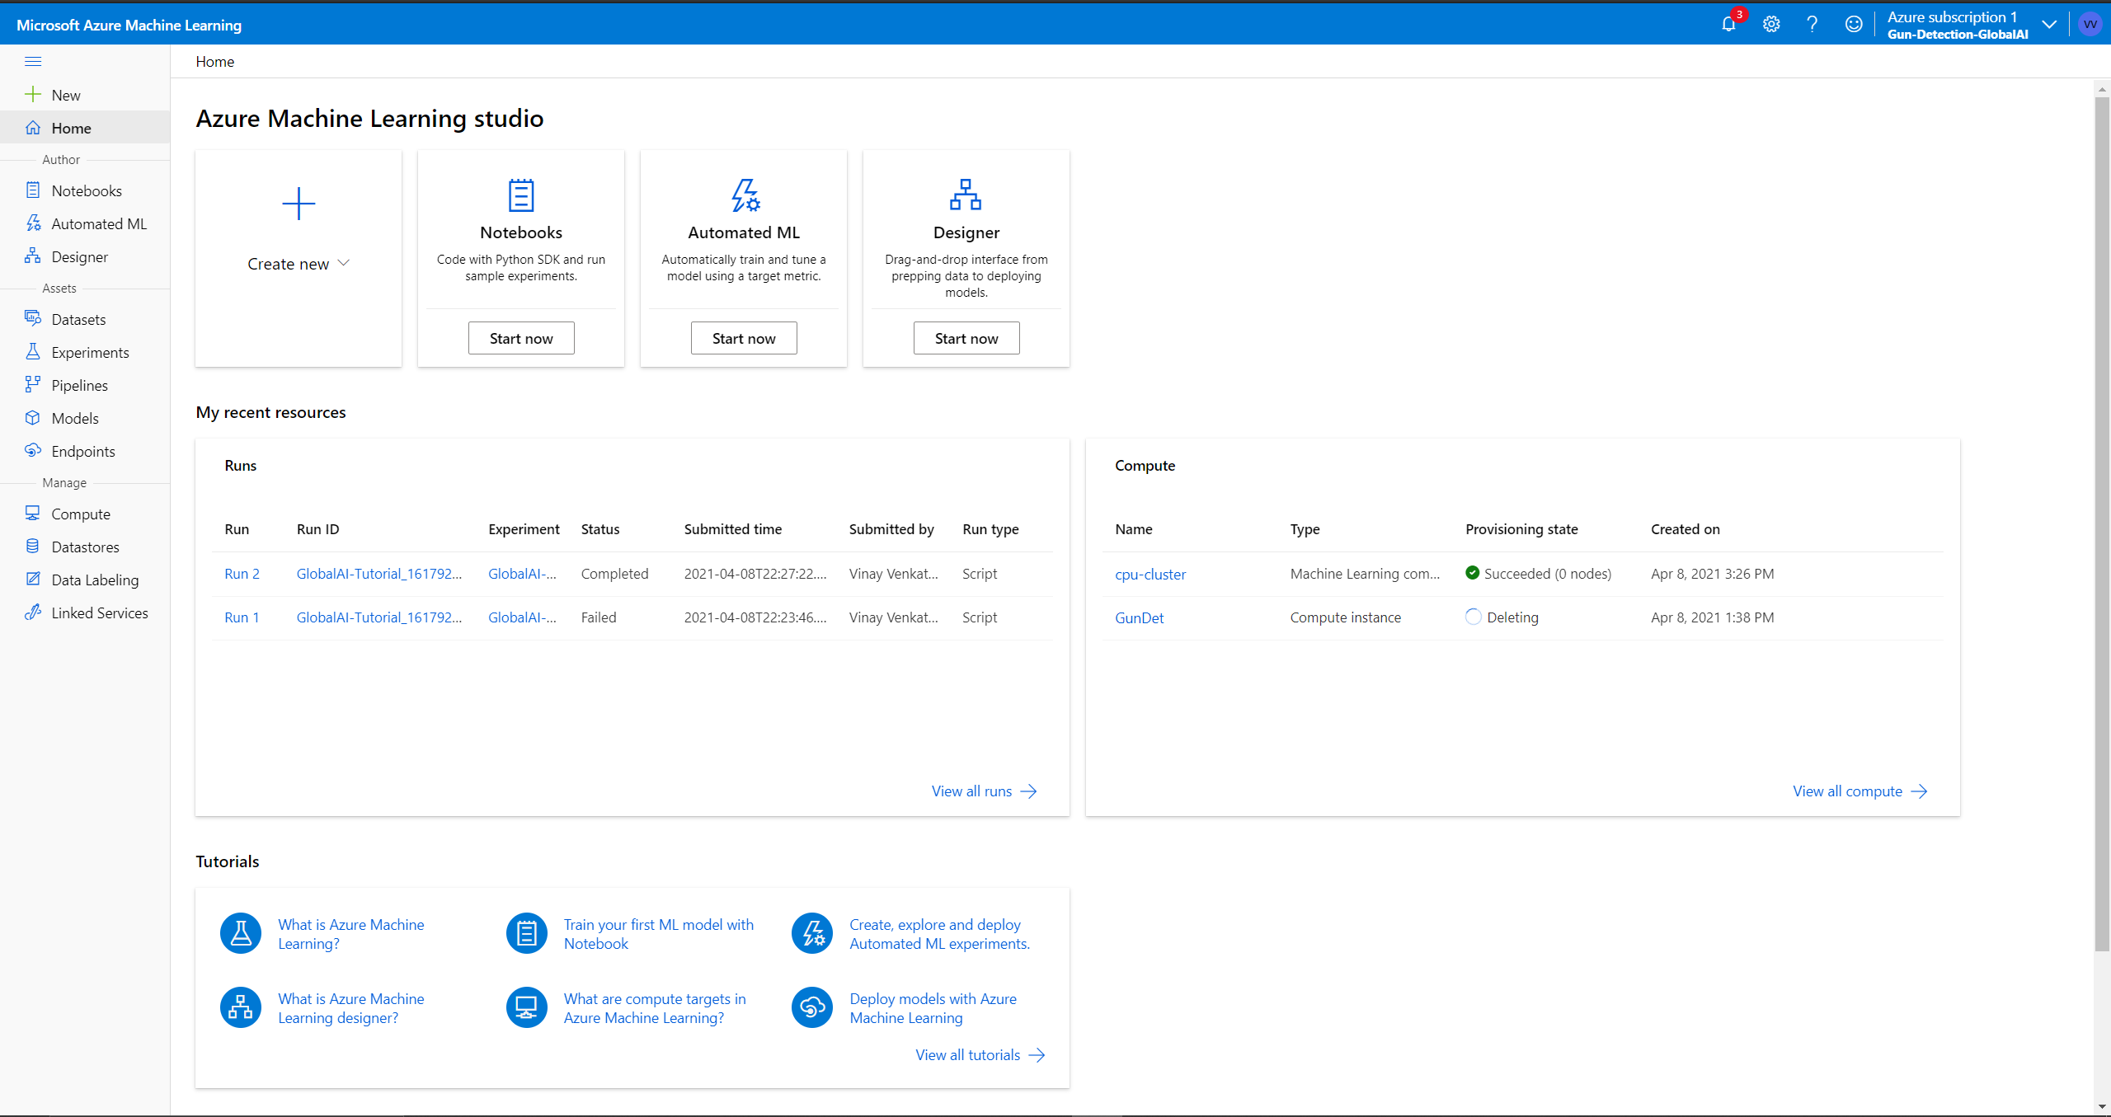
Microsoft Azure ML Platform
AzureML
Built in Jupyter Notebooks
Python
Matplotlib, numpy,

Slide 7
Demo
Image Classification using Azure ML Platform.

Slide 8
Recap
Why is AI the future?
Examples of how AI may benefit our future
Existing AI Solutions
Image classification demo with Microsoft Azure ML Platform

Slide 9
Thank You Everyone!
Vinayven.com
GitHub.com/Simple2006
Linkedin.com/in/vinayven

